Slide 1

UK Train Rides Analysis

Slide 2
Team Members
Mariam Mahmoud
Jumana Hossam
Shaza Ahmed
Mennatullah Omar
Meram George
Data Cleaning
Data Cleaning
Data Modelling
Data Visualization
Data Visualization

Slide 3
Table of content
01
03
PROJECT OVERVIEW
MODELLING
02
04
DATASET DESCRIPTION
KPIS AND CHARTS

Slide 4

01.
PROJECT
OVERVIEW

Slide 5

Overview
Train travel in the UK offers a convenient and scenic way to explore the country, with an extensive network connecting cities, countryside towns, and coastal regions.
The main purpose for this project is to assess its performance focusing on key aspects of ticket purchases, journey performance, and customer experience. The analysis should help the business owners to know how the system operates, how much it makes and how they can make it more profitable and efficient.

Slide 6
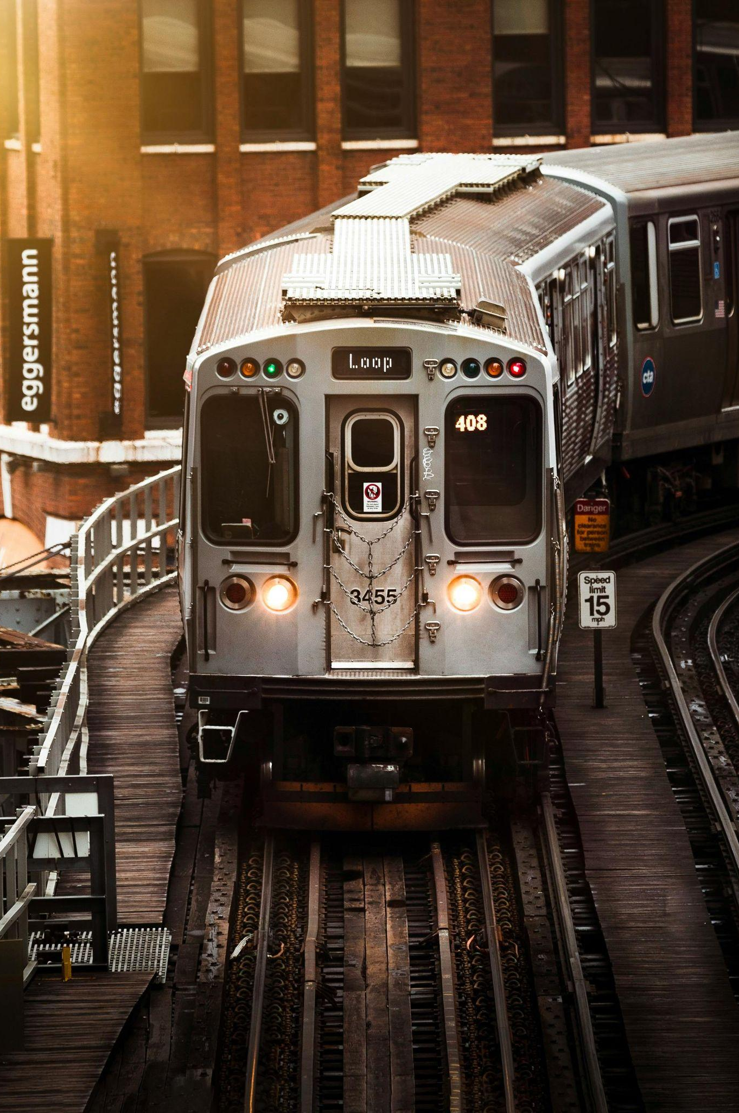
02.
DATASET DESCRIPTION

Slide 7
Contents of the dataset
The dataset consists of one file: railway.csv
Fields inside the file:
Transaction ID - Unique identifier for an individual train ticket purchase
Date of Purchase - Date the ticket was purchased
Time of Purchase - Time the ticket was purchased
Purchase Type - Whether the ticket was purchased online or directly at a train station
Payment Method - Payment method used to purchase the ticket (Contactless, Credit Card, or Debit Card)
Railcard - Whether the passenger is a National Railcard holder (Adult, Senior, or Disabled) or not (None)
Ticket Class - Seat class for the ticket (Standard or First)
Ticket Type - When you bought or can use the ticket (Advance, Off-Peak, Anytime)
Price - Final cost of the ticket
Departure Station - Station to board the train
Arrival Destination - Station to exit the train
Date of Journey - Date the train departed
Departure Time - Time the train departed
Arrival Time - Time the train was scheduled to arrive at its destination (can be on the day after departure)
Actual Arrival Time - Time the train arrived at its destination (can be on the day after departure)
Journey Status - Whether the train was on time, delayed, or cancelled
Reason for Delay - Reason for the delay or cancellation
Refund Request - Whether the passenger requested a refund after a delay or cancellation

Slide 8
Problems of Data
Same value Different Representation
Empty Cells
Duplicates (need normalization)
Errors in values

Slide 9

03.
MODELLING

Slide 10
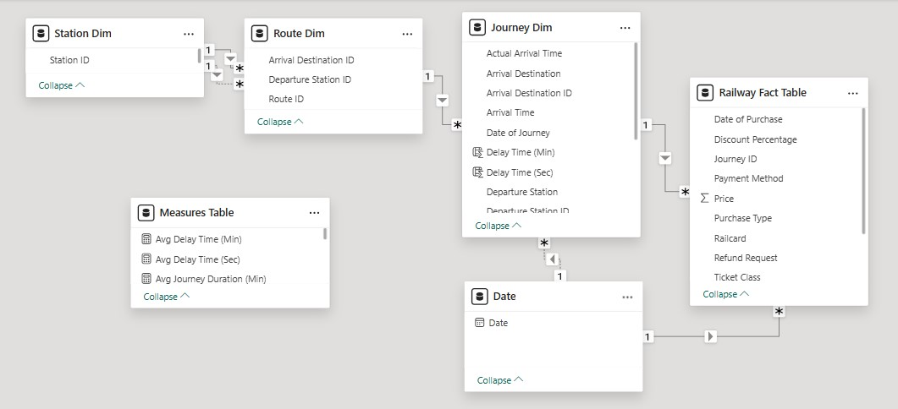
Semantic Model

Slide 11
Railway Fact Table
Columns
Transaction ID
Journey ID (Foreign key for journey)
Date of Purchase (Foreign key for date)
Time of Purchase
Purchase Type
Payment Method
Ticket Class
Ticket Type
Price
Discount Percentage (added using M Language)
Railcard
Refund Request

Slide 12
Dimensions
Journey Dim Columns
Route Dim Columns
Journey ID (Primary key for journey)
Route ID (Foreign key for route)
Date of Journey (Foreign key for date)
Departure Station
Departure Time
Arrival Destination
Arrival Time
Actual Arrival Time
Journey Status
Reason for Delay
Route ID (Primary key for route)
Departure Destination (Foreign key for station)
Arrival Destination (Foreign key for station)
Station Dim Columns
Date Dim Columns
Station Name (Primary key for station)
Date (Calendar added using DAX)

Slide 13

04.
KPIS AND CHARTS

Slide 14
KPIs Categories
Operational Performance
Sales & Revenue
- Number Of Journeys
- Number Of Routes
- Number Of Stations
- Cancellation Rate
- Delay Rate
- Average Delay Time
- Average Journey Duration
- Total Revenue
- Total Refunded Amount
- Number of Tickets Sold
- Refunded Request Rate

Slide 15
Charts Categories
Sales & Revenue
Operational Performance
Customer Behavior
- Sales By Purchase Type
- Sales By Payment Method
- Sales By Ticket Class
- Sales By Railcard Type
- Sales By Journey Date
- Total Revenue By Journey Date
- Sales By Purchase Date
- Number Of Journeys By Journey Date
- Delay Reasons Analysis
- Journey Status Distribution
- Delay/Cancel Rate on each Route
- Average Delay Time on each Route
- Demand On Each Journey
- Peak Time Through Day For Departure

Slide 16
Data insights
Table of Contents
Refund Rate on each Ticket Type
Delay & Cancellation Rate of each Route
Purchase Type on each Railcard
Journey Date

Slide 17
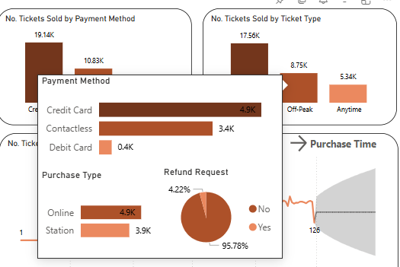
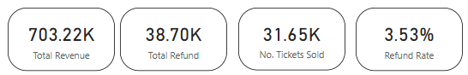
Data insights
Refund Rate on each Ticket Type

Slide 18
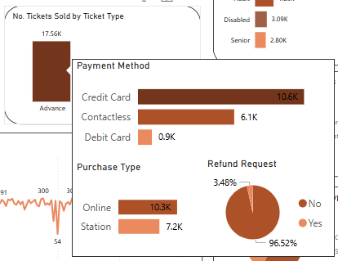
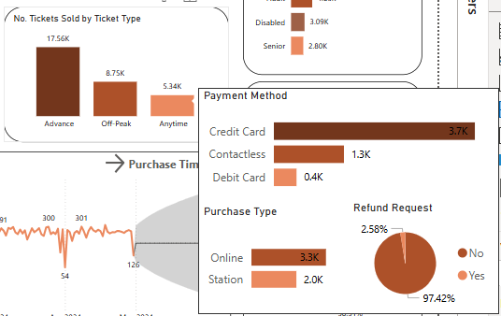
Data insights
Refund Rate on each Ticket Type

Slide 19
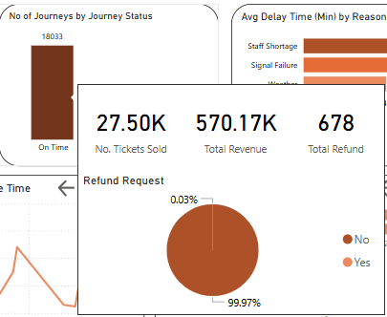
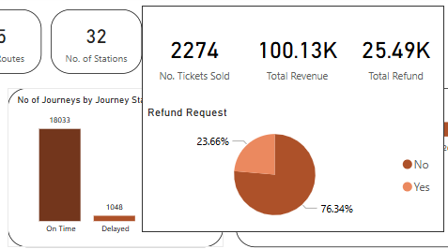
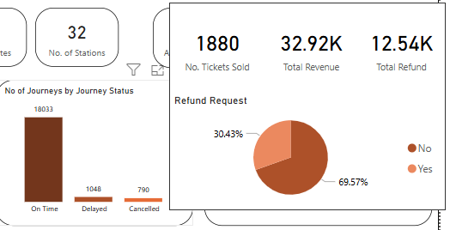
Data insights
Refund Rate on each Ticket Type

Slide 20

Data insights
Refund Rate on each Ticket Type
Exploration:
The percentage of refund on each Ticket Type in order are:
Off-Peak: 4.22%
Advance: 3.48%
AnyTime: 2.58%
The percentage of refund on each Journey Status in order are:
Cancelled: 30.43%
Delayed: 23.66%
On Time: 0.03%

Slide 21
Data insights
Refund Rate on each Ticket Type
Suggested Explanation:
Suggested Strategy:
Discounts can be applied on Anytime tickets.
Make a disclaimer about off-peak tickets on the website when purchasing.
Resolve the delay and cancellation reasons for journeys.
- Off-peak tickets can be used only on off-peak hours (weekdays between 6-8am and 4-6pm), so may be after purchasing them online they can not use it on peak hours.

Slide 22
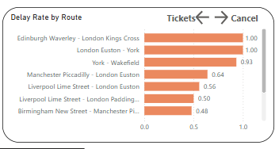
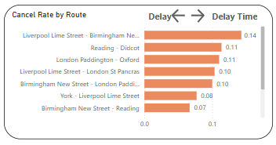
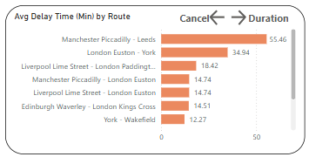
Data insights
Delay & Cancellation Rate of each Route

Slide 23
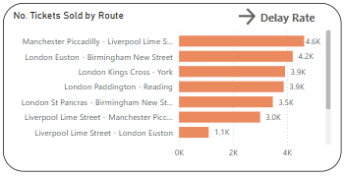
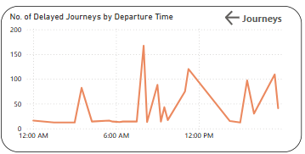
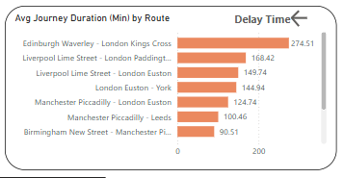
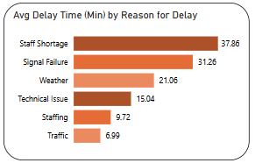
Data insights
Delay & Cancellation Rate of each Route

Slide 24

Data insights
Delay & Cancellation Rate of each Route
Exploration:
Journeys with the most delay rate (where Staff Shortage is the most common delay reason) in order:
Edinburgh Waverley - London King Cross
London Euston - York
York - Wakefield
Manchester Piccadilly - London Euston
Liverpool Lime Street - London Euston

Slide 25
Data insights
Delay & Cancellation Rate of each Route
Exploration:
Journeys with the most cancellation rate in order:
Liverpool Lime Street - Birmingham New Street
Reading - Decot
London Paddington - Oxford
Liverpool Lime Street - London st Pancras
Birmingham New Street - London Paddington

Slide 26
Data insights
Delay & Cancellation Rate of each Route
Suggested Explanation:
Suggested Strategy:
- London Euston has the most delay rate that can be caused by staff shortage.
- Liverpool Lime Street, Birmingham New Street, London Paddington has the most cancellation time that can be caused by the same issue (data unavailable to analyze this part)
- Hire more staff on the stations with the most delay and make better schedules to cover all hours along the day (The most delay is at 08:00 AM and 11:00 AM).

Slide 27
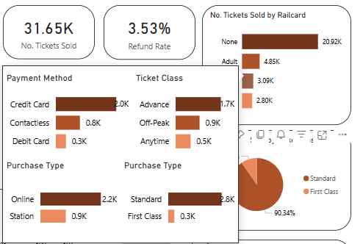
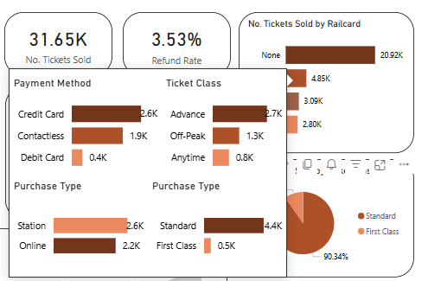
Data insights
Purchase Type on each Railcard

Slide 28

Data insights
Purchase Type on each Railcard
Exploration:
According to the Purchase Type percentage on each Railcard are:
Adult: most likely to purchase from station
None, Disabled, Senior: most likely to purchase online
Suggested Explanation:
- Disabled and seniors can not wait in long lines to purchase tickets.

Slide 29
Data insights
Purchase Type on each Railcard
Suggested Strategy:
Encourage all customers to purchase online (which will make lines shorter) by making discounts for those who purchase online.
Encourage the disabled to purchase online by making an application with accessibility to people with special needs (like deaf, and blind).

Slide 30
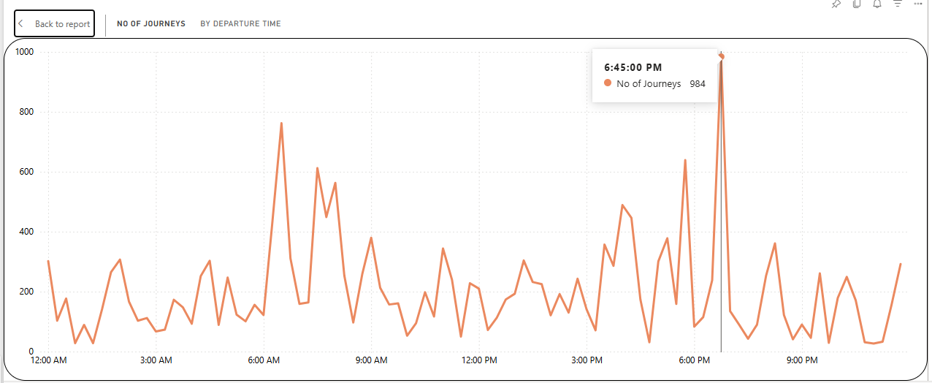
Data insights
Peak Time for Journeys

Slide 31
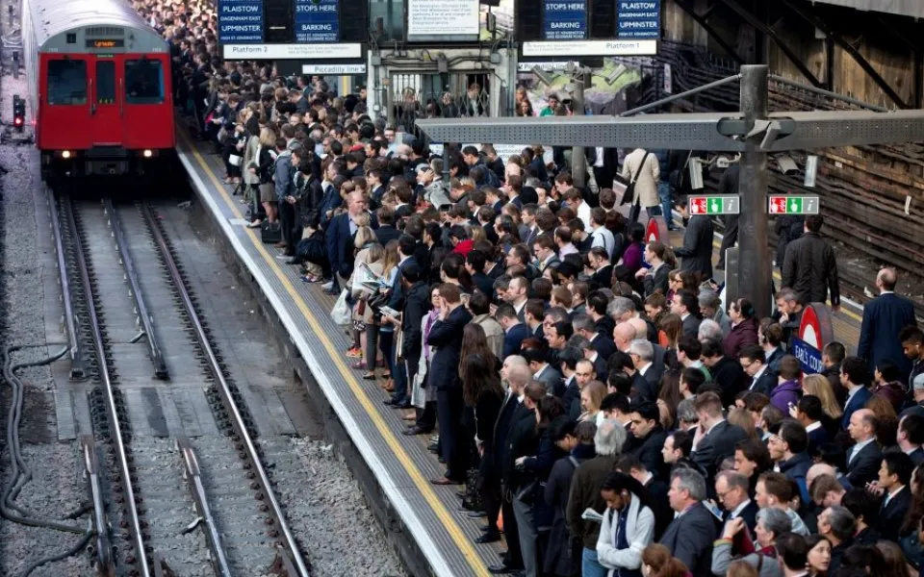
Data insights
Purchase Type on each Railcard
Exploration:
- It is noticed that the peak hours for departure are at 06:30 AM, 07:30 AM and 06:45 PM.
Suggested Explanation:
- Number of journeys at these hours are big, because of commuting.
Suggested Strategy:
- It is needed to have more staff in rush hours and have regular maintenance on the vehicles.

Slide 32
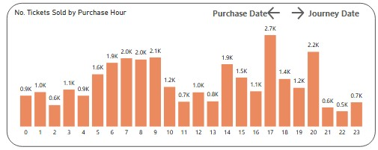
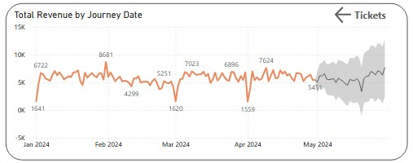
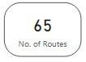
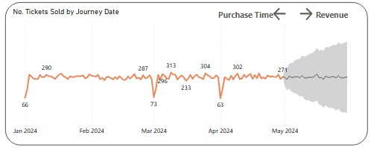
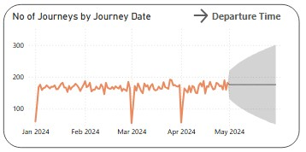
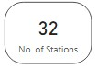
Data insights
Journey Date

Slide 33
Thanks!

